Slide 1
PYTHON WITH AI
Prepared by Sir Haroon

Slide 2
LECTURE 24
Method Overriding, Method Overloading & Dunder Methods

Slide 3
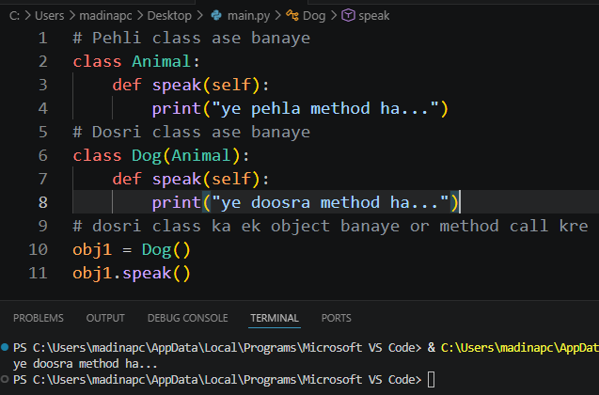
METHOD OVERRIDING
The process of declaring two methods with same name from parent class to child class and calling its object is known as method overriding in OOP.

Slide 4
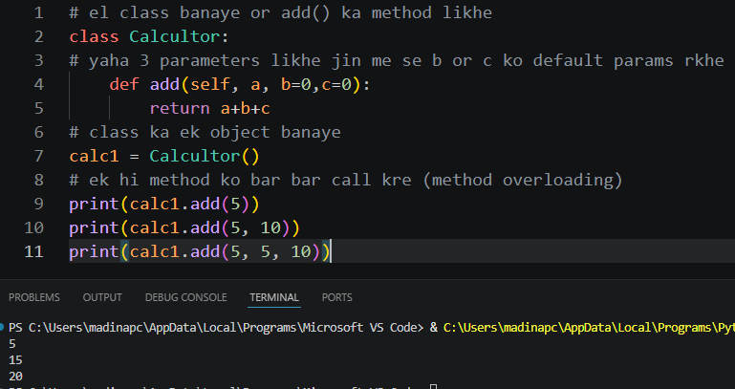
METHOD OVERLOADING
The process of using one function with multiple number of parameters instead of defining multiple functions for different paramater.

Slide 5
DUNDER METHODS
Special methods in python are predefined methods with names starting and ending with double underscores (__init__) that python calls implicitly under the hood to execute specific built-in operations. They are widely referred to as dunder methods
(Short for double underscore) or magic methods.
They enable powerful object-oriented programming (oop)
Capabilities like operator overloading and customization of class behaviors.

Slide 6
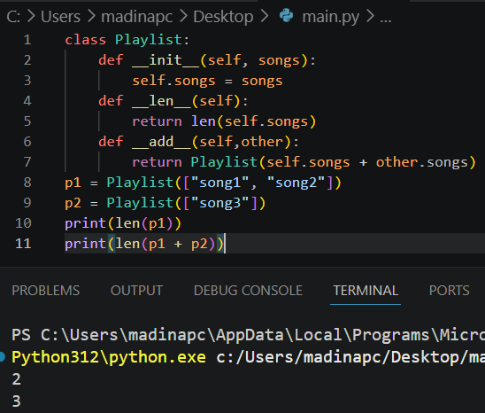
DUNDER METHOD USAGE EXAMPLE

